Slide 1
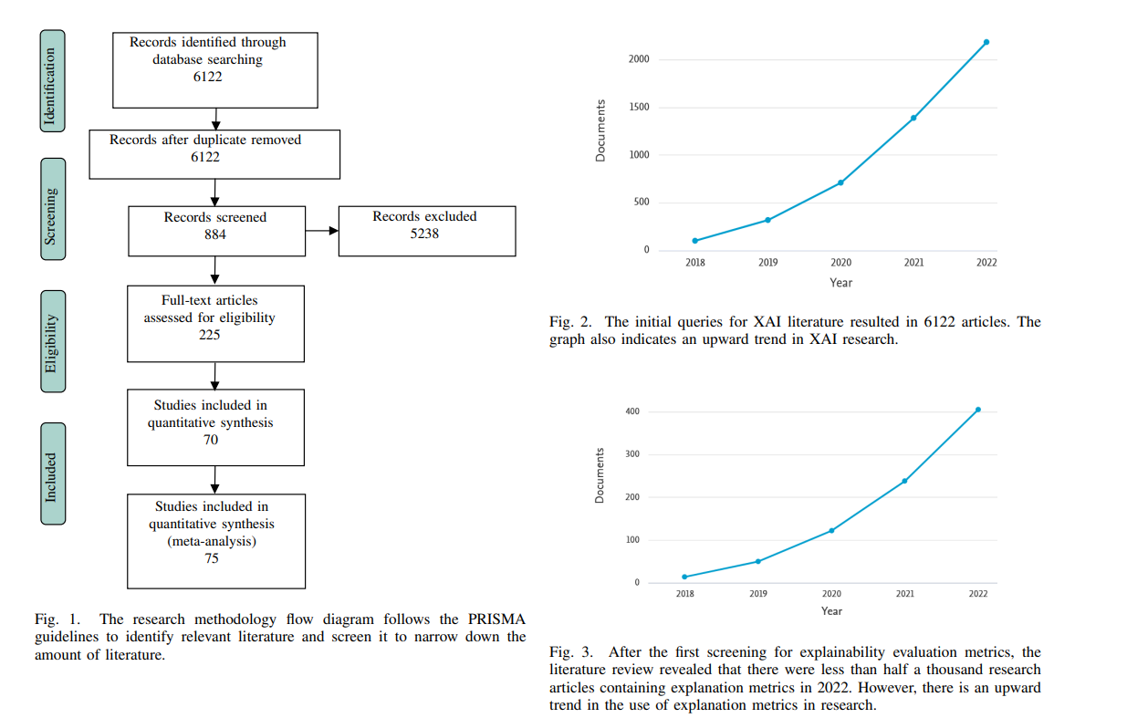
State of XAI Evaluation Metric
Only 75 papers included quantitative evaluation metrics (EM) in XAI for over 7000 papers screened (07/2023)
A rise of using XAI explanation in research, but lack of EM for Explainability
=> Indicate a lack of systematic, reliable EM for Explainability in XAI field
Src: [2310.08537] XAI Benchmark for Visual Explanation

Slide 2
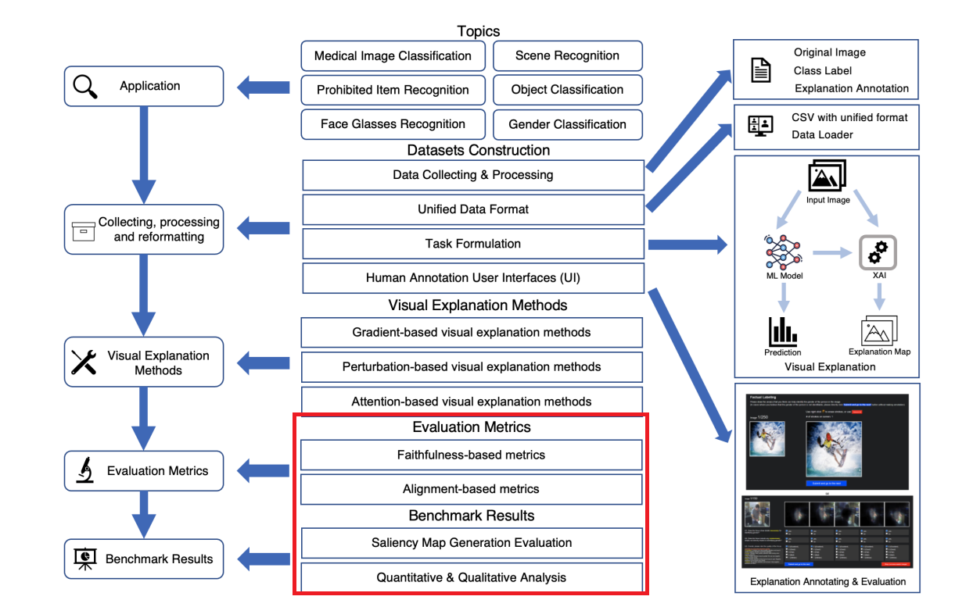
XAI Benchmark for Visual Explanation
In the papers below, the author stated there is a lack of method for XAI quantitative evaluation metric (QEM) on image data
Popular dataset in Image like CIFAR-10, CIFAR-100 often lack of ground-truth (GT) annotation for pixel-wise level
Most of existing QEM still rely on surveys/questionnaires of human expert
The red box on beside image show XAI image lack of EM for those techniques
Src: [2310.08537] XAI Benchmark for Visual Explanation

Slide 3
2. XAI visual techniques/method for Explanation image data
Heatmap
Perturbation-based
Gradient-based
Attention-based
RISE(*)
CAM family
GradCAM
HiresCAM
ScoreCAM..
(*) RISE stands for Randomized input sampling for explanation of black-box models
[1806.07421] RISE: Randomized Input Sampling for Explanation of Black-box Models

Slide 4
3. XAI evaluation metric for Explanation
Evaluation metric
Alignment-based
Faithful-based
IOU
Precision
Recall
F1
Pointing Game
Average Drop % score
Deletion
Insertion

Slide 5
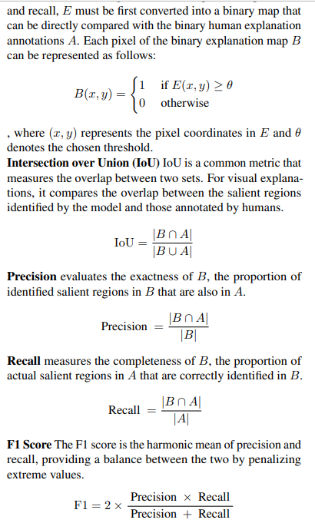
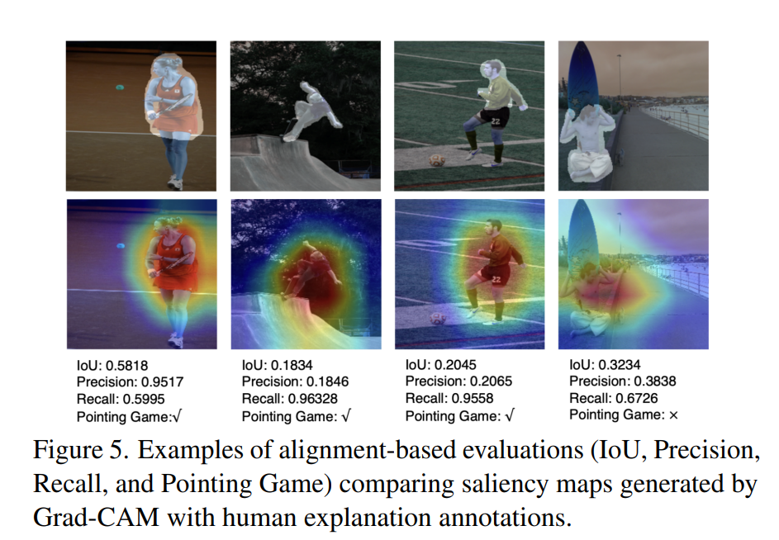
3.1 Alignment-based evaluation metric
Alignment-based: Compare between Explanation created by XAI methods and human GT pixel-wise level to see the alignment, mainly used to calculate correlation between Model’s Explanation and Human’s Explanation

Slide 6
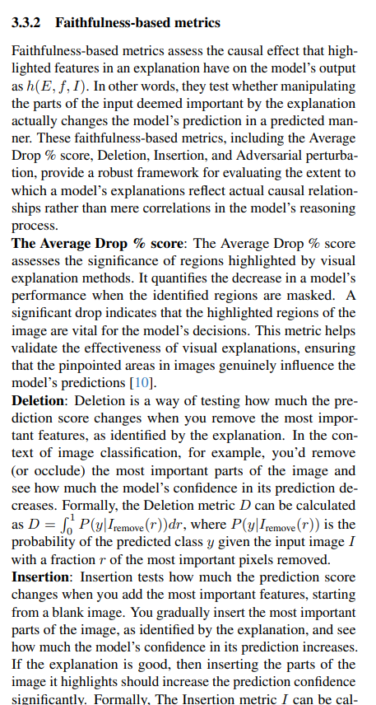
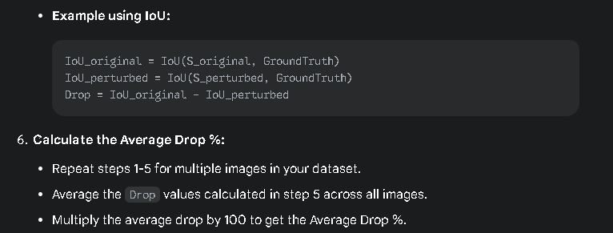
3.2 Faithful-based evaluation metric
Faithful-based: Randomly mask/delete/add important highlighted pixels in images by Explanation and compare prediction performance with the original image, mainly used to calculate correlation between Model’s Explanation and Model’s Prediction

Slide 7
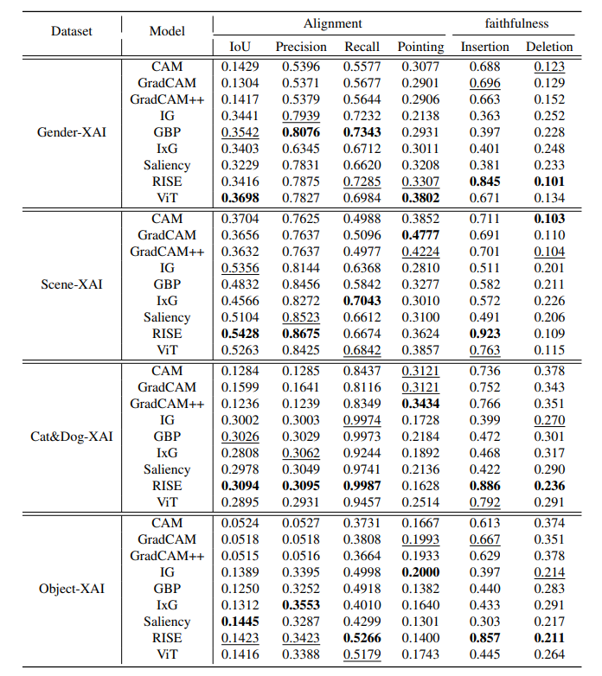
4 Sample benchmark table used in paper
For each dataset (Gender, scene,..), the author used multiple XAI methods to create explanation
For each explanation, the author benchmark them using different evaluation metrics like IOU, Precision, Deletion,...

Slide 8
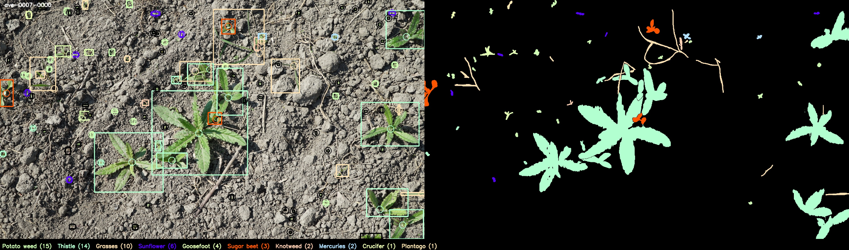
Dataset Used: Weed and Crop Dataset
Overall: The newest and big-scale agriculture dataset with over 75 classes (include both many type of crops and weeds)
Total of over 8000 images, collected from both wild and controlled environment
Contain both B-box annotation and pixel-wise level annotation and can be used for many tasks in CV with many variant annotations: WeedAndCrop, WeedOrCrop9, WeedOrCrop2, Fine24,..
The dataset is quite new (published in 2023, at WACV) and have not tested by many researchers/practitioners
The CropAndWeed Dataset: A Multi-Modal Learning Approach for Efficient Crop and Weed Manipulation
GitHub - cropandweed/cropandweed-dataset: Information and scripts for the CropAndWeed Dataset

Slide 9
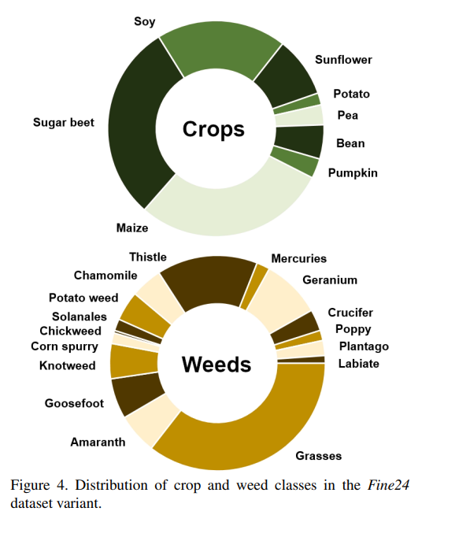
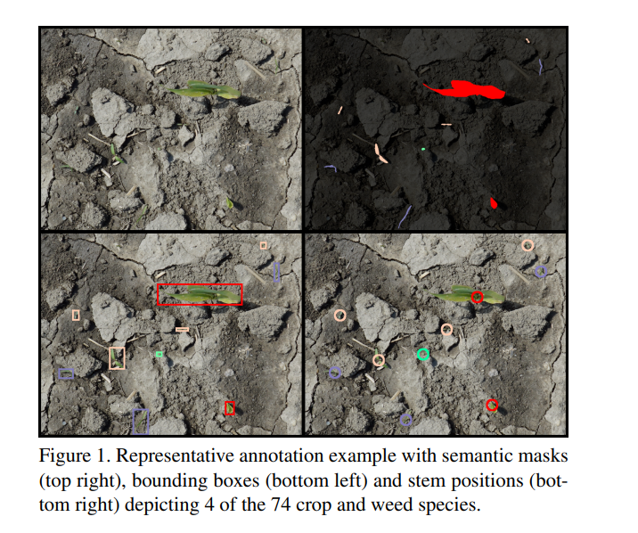
Dataset Classes Info

Slide 10
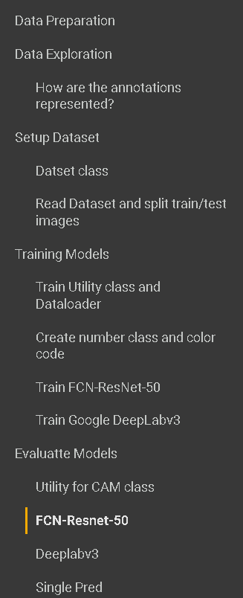
XAI methods used in our project
In this project, our group aims to use at least 2 DL models, it could be FCN Resnet50 and Deeplabv3
WeedOrCrop9/WeedOrCrop2 annotations will be used to train and evaluate benchmark for some xAI Explanation method (GradCAM, HiresCAM,.)
We will create benchmark tables and give conclusion

